Slide 1

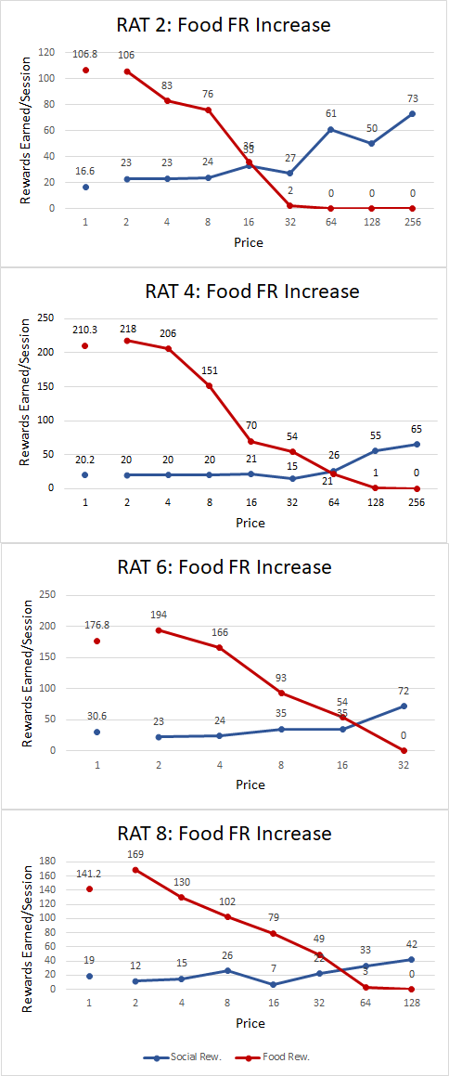
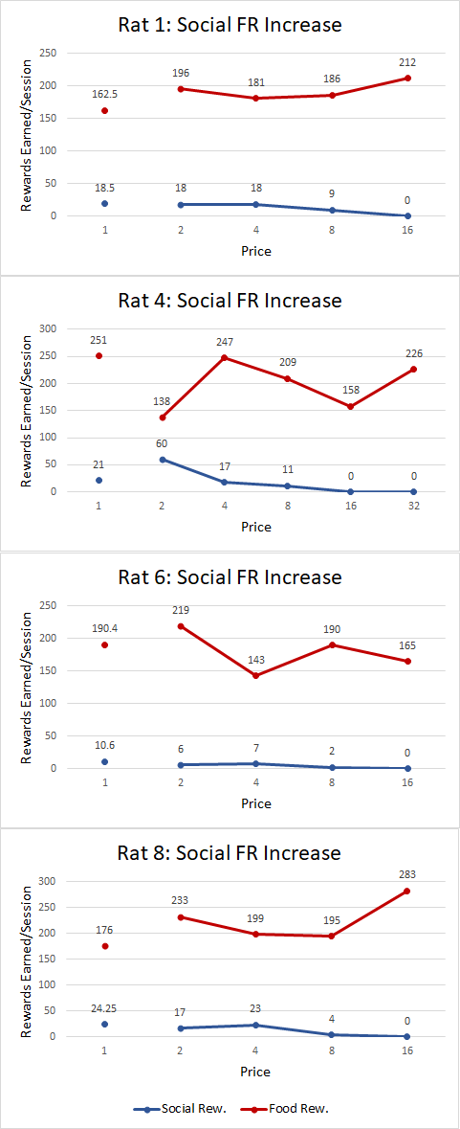
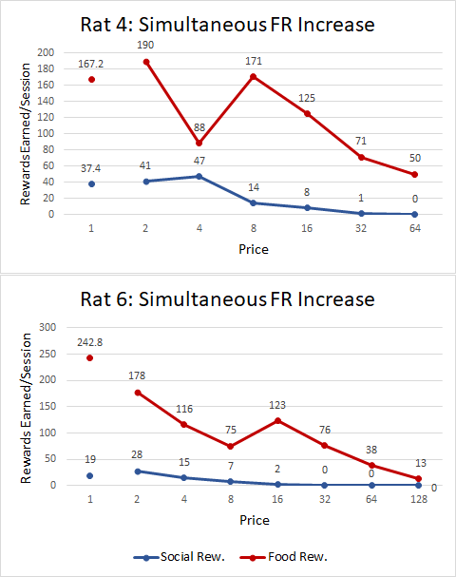
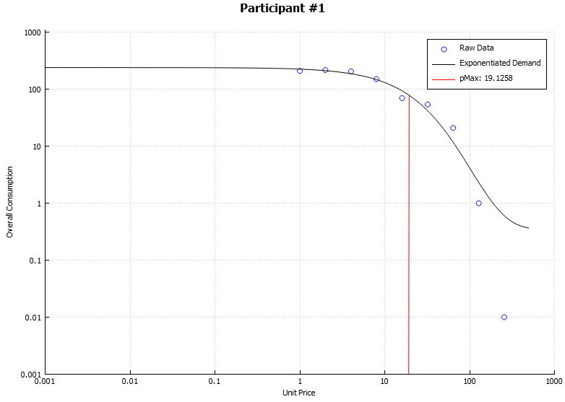
Assessing Cross-Price Interactions Between Food and Social Reinforcement
Cyrus Kirkman, Matt Wan, Carol Franceschini, and Timothy Hackenberg
Reed College Psychology Department
Background
Results
Previous studies have established that rats will work to free a partner rat for social interaction.
The present experiment aimed to create a functional model in which the reinforcing value of social reward can be contextualized in terms of an alternative reinforcers, such as food.
As all consumption of rewards occured in the same location, the model bypasses effects of CPP.
Findings show that the independent and relative value of SR+ across subjects could be contextualized and compared and different FR price points.
Across all subjects, FR+ were shown to be more elastic than SR+ in that extinction of social rewards occured at a much lower price compared to extinction of food rewards.
Can social reinforcement value be quantified and contextualized through FR price manipulation of concurrent reward choices?
Conditions from left to right: FR+ increase for rats 2, 4, 6, and 8, SR+ increase for rats 1, 4, 6, and 8, and simultaneous FR+/SR+ increase for rats 4 and 8.
Methods
Four decision making rats were trained to choose and work for either releasing a partner rat for 10s social interaction (SR+) or a food pellet (FR+) with 10s timeout throughout a 60 minute session.
Discussion
Applications
Apparatus used with SR+ tied to the LL from the left chamber and FR+ tied to the RL in the trough.
Across FR+, SR+, and simultaneous FR increase conditions, the number of rewards earned per trial by subjects systematically decreased as price of reward increased; decrease of rewards earned followed an elastic drop-off curve.
This experimental model has potential to compare the relative reinforcing value of any two goods and better understand social rewards.
Rats were trained on a concurrent FR1 FR1 schedule as a baseline prior to each of the three conditions:
FR+ Increase: price of FR+ geometrically increased until reward extinction with SR+ price held constant
SR+ Increase: price of SR+ increased until reward extinction with FR+ held constant.
Simultaneous FR+/SR+ Increase: price of SR+ and FR+ raised simultaneously until reward extinction
Application of exponentiated demand curve to Rat 4 FR+ increase data
Additionally, enforcement of a two-good world with controlled income allows the application of many economic models to measure behavior.
Acknowledgments
Funded in part by the Reed Opportunity Grant.

